Slide 1
https://www.youtube.com/watch?v=4BPU5mKipNo
List key words in the song.
What do these words have in common?

Slide 2
Your City –
Your Future –
Your decisions.

Slide 3

Sustainable Cities – What does the word sustainable mean?

Slide 4
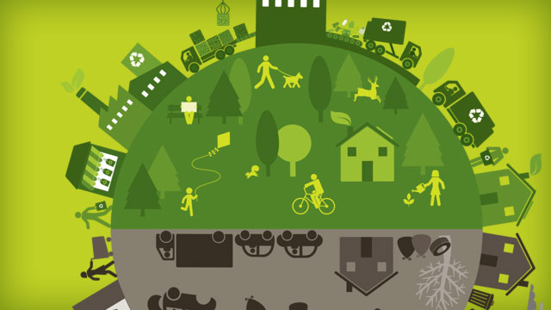
What were some of the issues facing cities of the future and the increasing population?

Slide 5

You are going to produce a city charter for your city. This is a document put together by the city for all residents to follow so that you can all work together towards a more sustainable future.

Slide 6

Energy - Your aim: To be the first city in world to use 100 per cent renewable energy.
You will need to state your aim of how your city will be powered. You should be using sustainable techniques such as wind power, hydro electricity and solar energy. Alternatively, you can come u with your own sustainable way to produce energy.

Slide 7
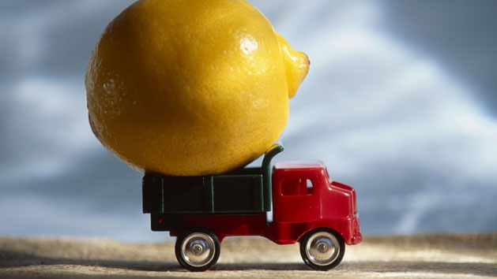
Food - Your aim: To reduce your food miles.
You should be encouraging the people of your cities to be aware and aiming to reduce how far the food has travelled to get o their plate. People will need to eat seasonal, local produce. Even better would be to get people growing their own vegetables, how could you encourage that?

Slide 8
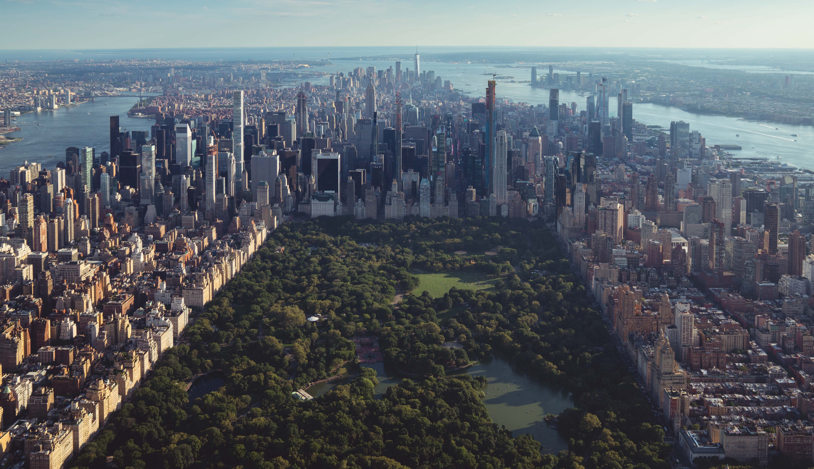
Nature - Your aim: Bring nature back to the city
We know how important green spaces are for humans and our well-being but more importantly the plants and animals they support in turn support us. How will you ensure your residents can enjoy plenty of green space in amongst the urban sprawl?

Slide 9
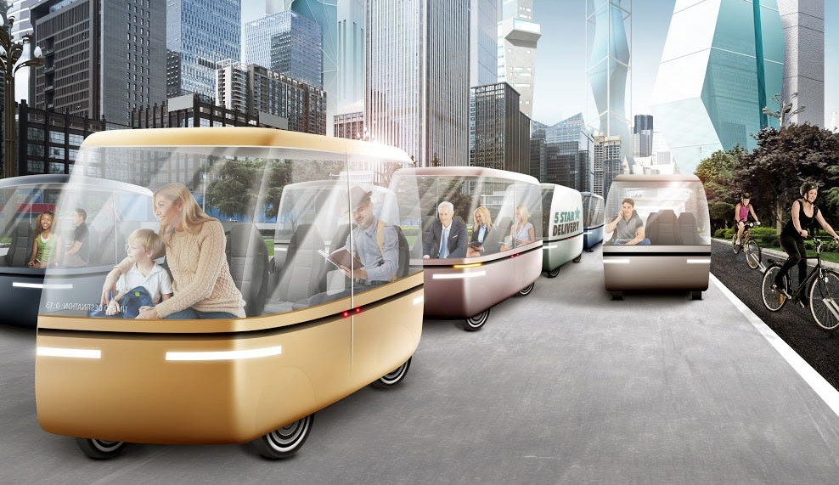
Transport - Your aim: Fewer cars and cleaner air
We have talked about the damage that cars do to our health and the environment. What can you provide as a city that will encourage people to use public transport? What will be the best method of getting around? It MUST be powered by a renewable energy source.

Slide 10

Waste – Your aim: Reduce, reuse and recycle
An important point to consider is how to make sure that your cities residents are doing as much as they can to reduce their waste – whether it be reusing clothes, making sure that what they do produce is efficiently recycled or by using less plastic and producing less food waste. They will need to think, how what they do produce, can be used.

Slide 11

Your City Charter
Make sure you have at least one point that covers each theme.
Make a bold claim of how your city will be the best at one of these points.
You will need to think carefully about how the city can achieve this claim.
Produce your city charter.

